Slide 1
Software Quality Engineering
Lecture 1
Part II-software testing
Functional testing
alina.arshad@nu.edu.pk

Slide 2
Cause-Effect Graphing Technique
Popular technique for small programs and considers the combinations of various inputs.
A technique to systematically select a high yield set of test cases.
Two terms: Causes and Effects, which are nothing but inputs and outputs respectively.
SRS document is used for the identification of causes and effects.
A list is prepared for all causes and effects.

Slide 3
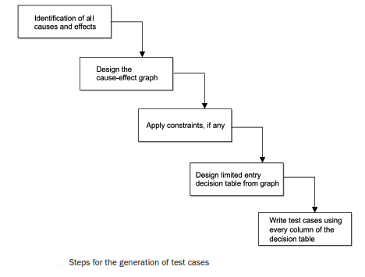
Cause-effect Graphing Technique

Slide 4
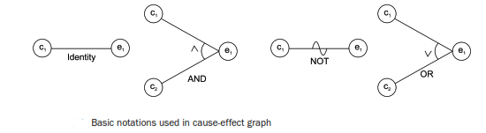
Design of Cause-Effect Graph
Each node represents either true or false state and may be assigned 1 and 0 value respectively.
Identity: This function states that if c 1 is 1, then e1 is 1; else e1 is 0.
NOT: This function states that if c 1 is 1, then e1 is 0; else e1 is 1.
AND: This function states that if both c 1 and c2 are 1, then e1 is 1; else e1 is 0.
OR: This function states that if either c 1 or c2 is 1, then e1 is 1; else e1 is 0. The AND and OR functions are allowed to have any number of inputs.

Slide 5
Use of Constraints in Cause-Effect Graph
Exclusive: The Exclusive (E) constraint states that at most one of c1 or c2 can be 1 (c1 or c2 cannot be 1 simultaneously). However, both c1 and c2 can be 0 simultaneously.
Inclusive: The Inclusive (I) constraints states that at least one of c1 or c2 must always be 1. Hence, both cannot be 0 simultaneously. However, both can be 1.
One and Only One: The one and only one (O) constraint states that one and only one of c1 and c2 must be 1
Requires: The requires (R) constraint states that for c1 to be 1, c2 must be 1; it is impossible for c1 to be 1 if c2 is 0.
Mask: This constraint is applicable at the effect side of the cause-effect graph. This states that if effect e1 is 1, effect e2 is forced to be 0
Notes:
Only causes notation:

Slide 6
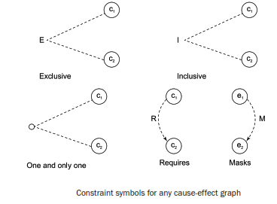
Use of Constraints in Cause-Effect Graph

Slide 7
Example
Consider the example of keeping the record of marital status and number of children of a citizen. The value of marital status must be ‘U’ or ‘M’. The value of the number of children must be digit or null in case a citizen is unmarried. If the information entered by the user is correct then an update is made. If the value of marital status of the citizen is incorrect, then the error message 1 is issued. Similarly, if the value of number of children is incorrect, then the error message 2 is issued.
The causes are:
c1 : marital status is ‘U’
c2 : marital status is ‘M’
c3 : number of children is a digit
and the effects are:
e1 : updation made
e2 : error message 1 is issued
e3 : error message 2 is issued

Slide 8
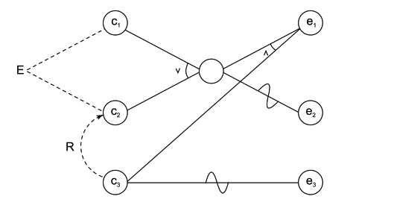
Solution
There are two constraints exclusive (between c1 and c2 ) and requires (between c3 and c2 ), which are placed at appropriate places in the graph. Causes c1 and c2 cannot occur simultaneously and for cause c3 to be true, cause c2 has to be true. However, there is no mask constraint in this graph.

Slide 9
applicability
Cause-effect graphing considers dependency of inputs using some constraints.
Effective only for small programs because, as the size of the program increases, the number of causes and effects also increases and thus complexity of the cause-effect graph increases.
For large-sized programs, a tool may help us to design the cause-effect graph with the minimum possible complexity.
Limited applications in unit testing and hardly any application in integration testing and system testing.

Slide 10
Pair-wise testing
Pairwise Testing is a test design technique that delivers hundred percent test coverage.
A black-box test design technique in which test cases are designed to execute all possible discrete combinations of each pair of input parameters.
Techniques like boundary value analysis and equivalence partitioning can be useful to identify the possible values for individual factors. But it is impractical to test all possible combinations of values for all those factors. So instead a subset of combinations is generated to satisfy all factors.
All-Pairs technique is very helpful for designing tests for applications involving multiple parameters. Tests are designed such that for each pair of input parameters to a system, there are all possible discrete combinations of those parameters. The test suite covers all combinations; therefore it is not exhaustive yet very effective in finding bugs

Slide 11
Example
An application with simple list box with 10 elements (Let's say 0,1,2,3,4,5,6,7,8,9) along with a checkbox, radio button, Text Box and OK Button. The Constraint for the Text box is it can accept values only between 1 and 100. Below are the values that each one of the GUI objects can take :
List Box - 0,1,2,3,4,5,6,7,8,9
Check Box - Checked or Unchecked
Radio Button - ON or OFF
Text Box - Any Value between 1 and 100
Exhaustive combination of the product B is calculated
List Box = 10
Check Box = 2
Radio Button = 2
Text Box = 100
Total Number of Test Cases using Cartesian Method : 10*2*2*100 = 4000
Total Number of Test Cases including Negative Cases will be > 4000

Slide 12
Any question????

